Slide 1
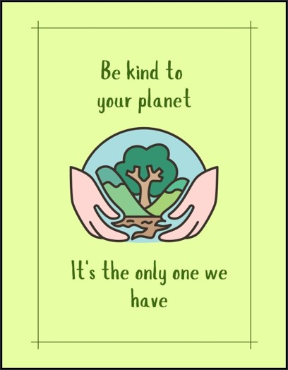
Environment & SDG Himalaya Fellowship
Made By:
Ujesh Sisodia 500091882
Hitendra Sisodia 500091910
Anirudh Srinivasan 500091739
Priyanshu Tandon 500091901
Kartikay Kanojia 500090998

Slide 2
Environment & SDG Himalaya Fellowship

Slide 3
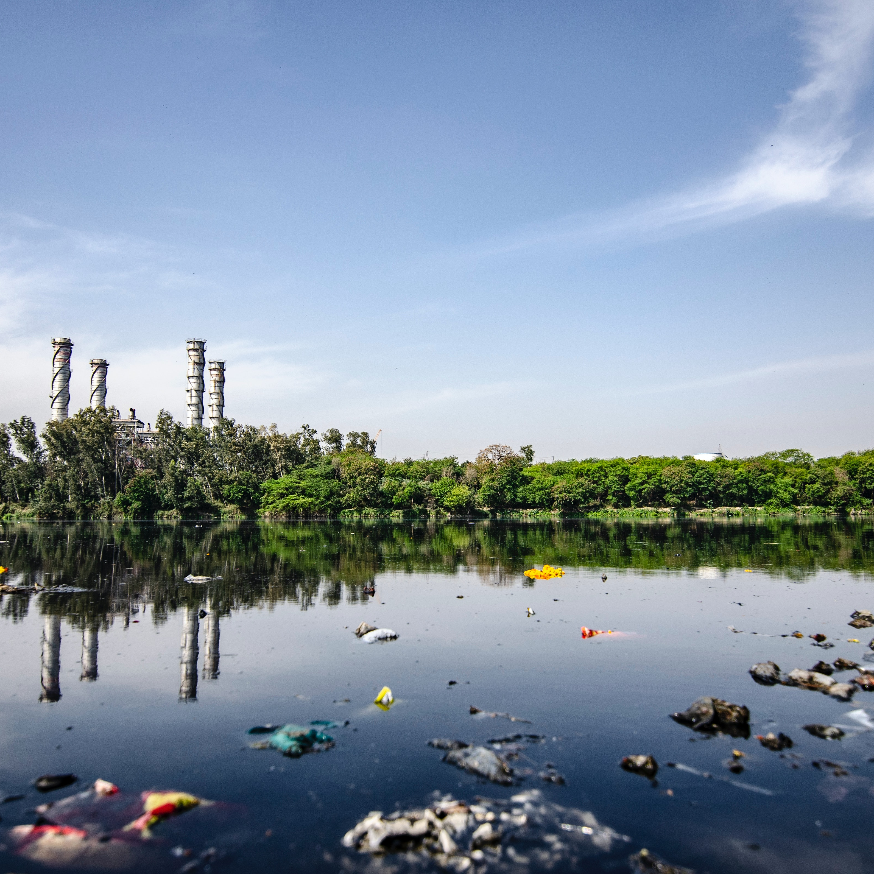
River Pollution

Slide 4
Agenda
1
2
3
4
5
Introduction
Objective
Literature Review
Methodology
Conclusion and Recommendation

Slide 5
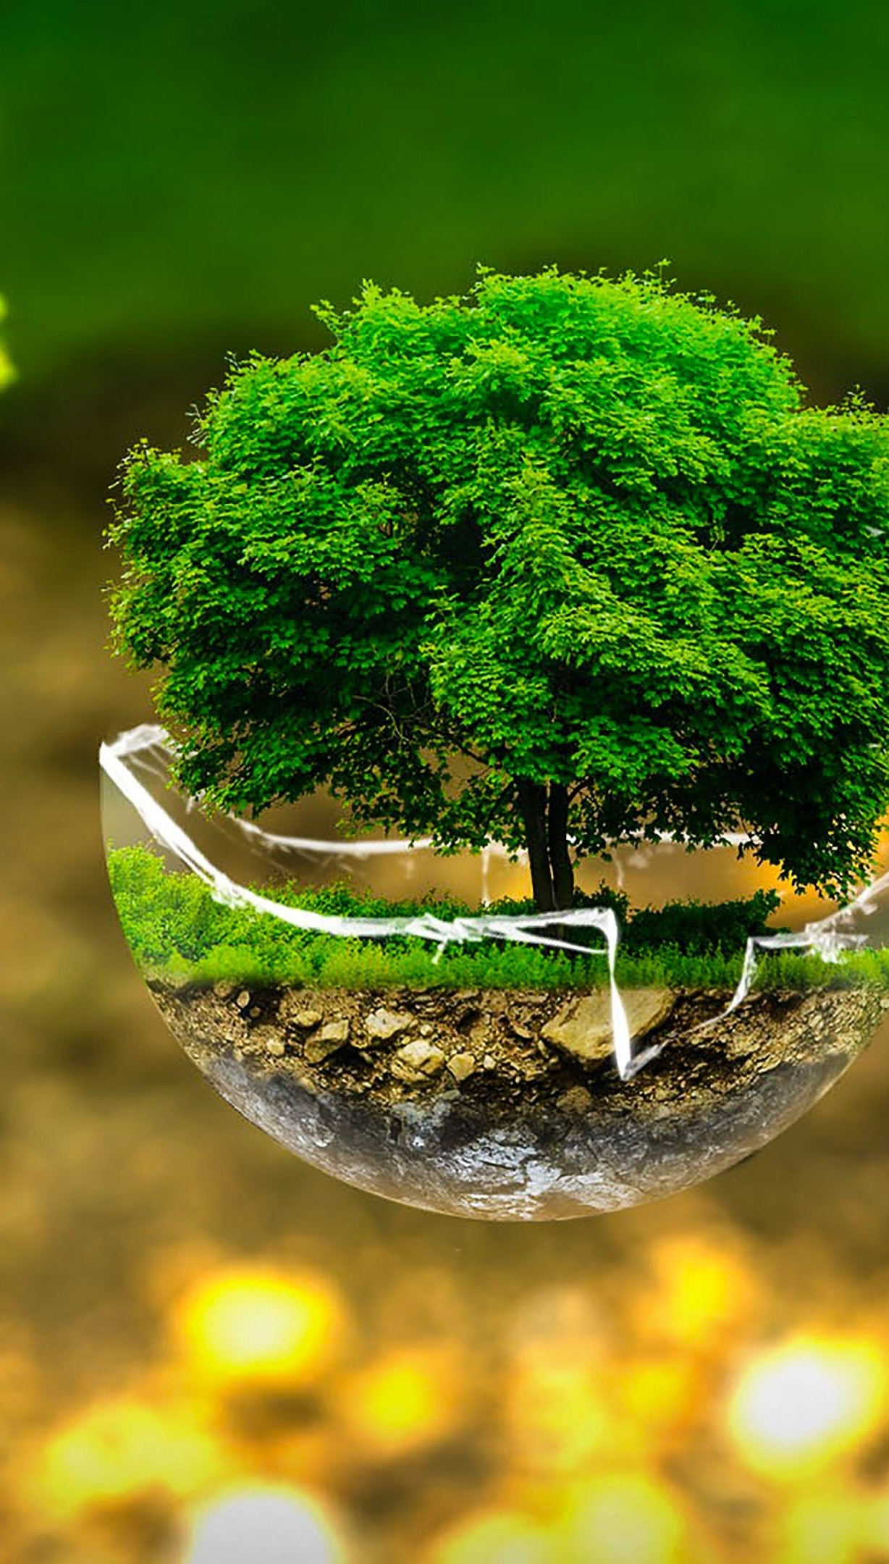
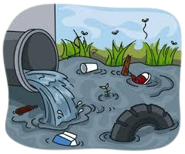
Introduction
Rivers are a vital source of freshwater.
Play a crucial role in sustaining the natural environment.
River pollution is a significant environmental issue.

Slide 6







Objective
Protecting human health
Improving water quality and access to clean water
Protecting the environment
Protecting aquatic life
Aware people about River pollution

Slide 7
Literature Review
Introduction
Sources of River Pollution
Impacts of River Pollution
Mitigation Measures
Conclusion

Slide 8
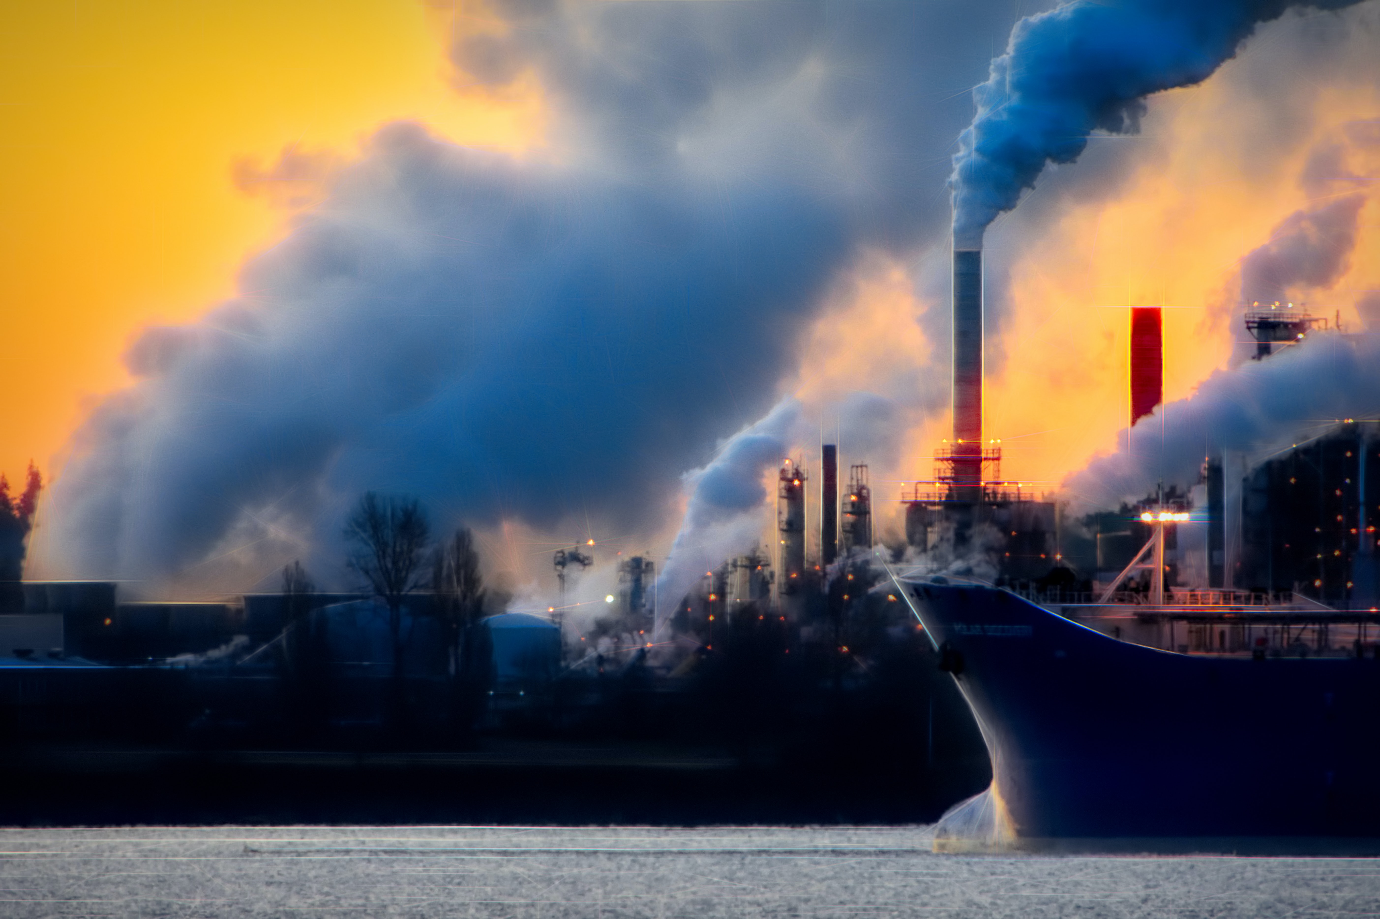
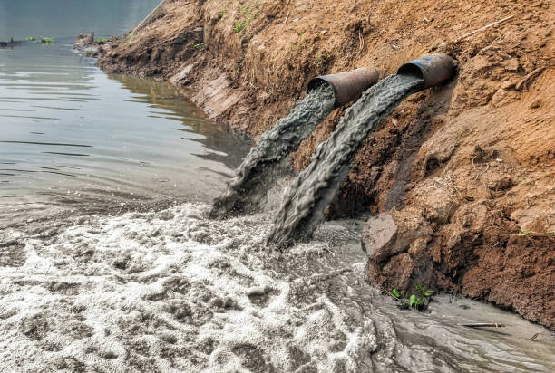
Sources of River pollution

Slide 9
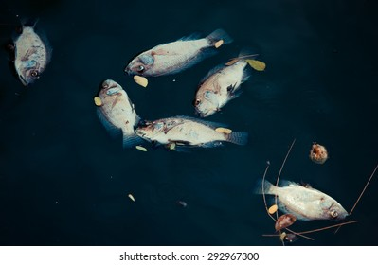
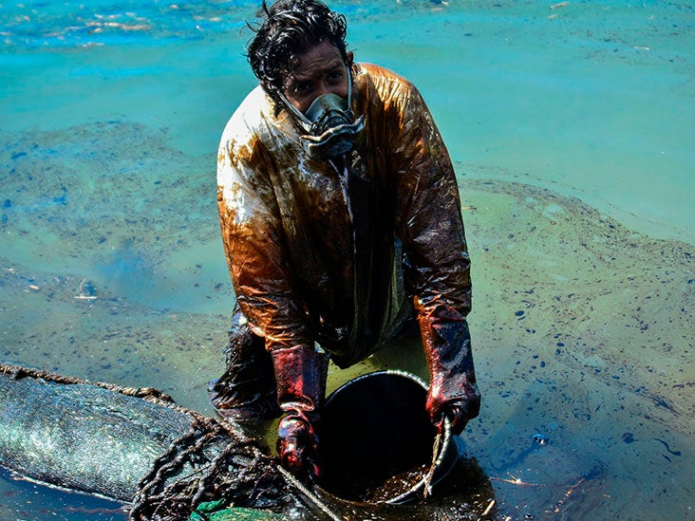
Impacts of River Pollution

Slide 10
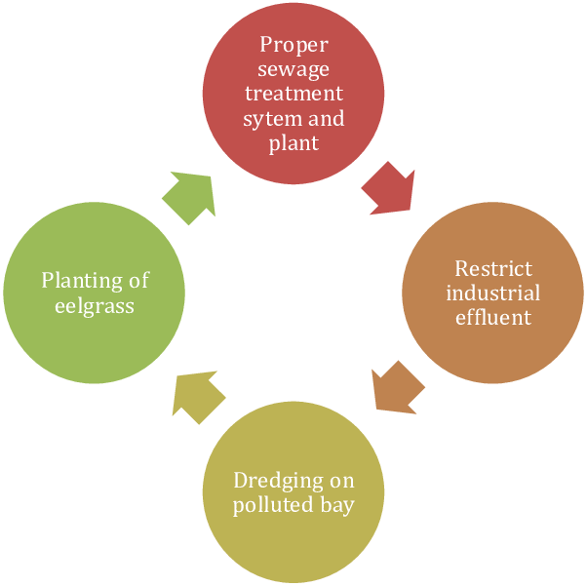
Mitigation Measures

Slide 11
Resultant Discussion
​
River pollution is a complex environment issue that affects both developed and developing countries worldwide.
​ ​
The impact of river pollution can vary from one location to another, depending on the type and amount of pollutants present in the water.
Efforts to address river pollution have been ongoing for decades, but much more needs to be done.

Slide 12
Methodology
Interpret the Results
Analyze data

Slide 13
Methodology
Identify the objective of the project
Conduct a literature review

Slide 14
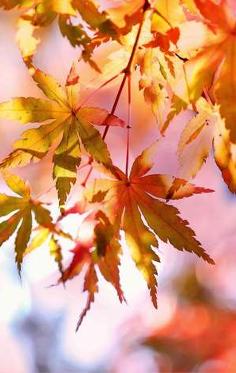
Conclusion and Recommendation
Serious environmental issue
Affects water bodies worldwide
Sources of river pollution
Impacts of river pollution

Slide 15
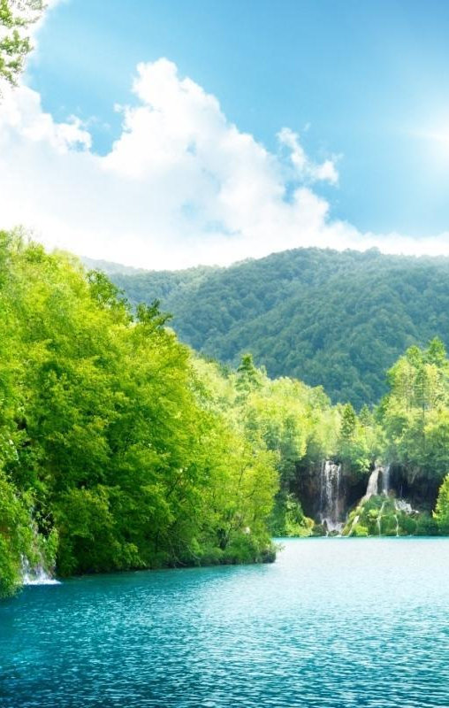
Conclusion and Recommendation
Strengthen regulations and policies
Increase funding for pollution control
Educate the public
Promote natural solutions

Slide 16
Reference and Bibliography
Vymazal, J. (2017). River water quality: The role of riparian vegetation buffers. International Journal of Environmental Research and Public Health, 14(10), 1206.
Hejazi, R., Hajrasouliha, I., & Kazemi, Z. (2020). River pollution and its environmental impacts. Environmental Science and Pollution Research, 27(8), 7926-7936.
Kumar, S., & Malhotra, S. K. (2019). Assessment of River Pollution: A Review of Selected Indices. Journal of Environmental Science and Engineering, 61(1), 1-17.
Jabeen, H., Iqbal, S., & Shah, M. H. (2020). Water pollution: Major sources, management, and recent developments in analytical methods. Environmental Monitoring and Assessment, 192(2), 77.

Slide 17
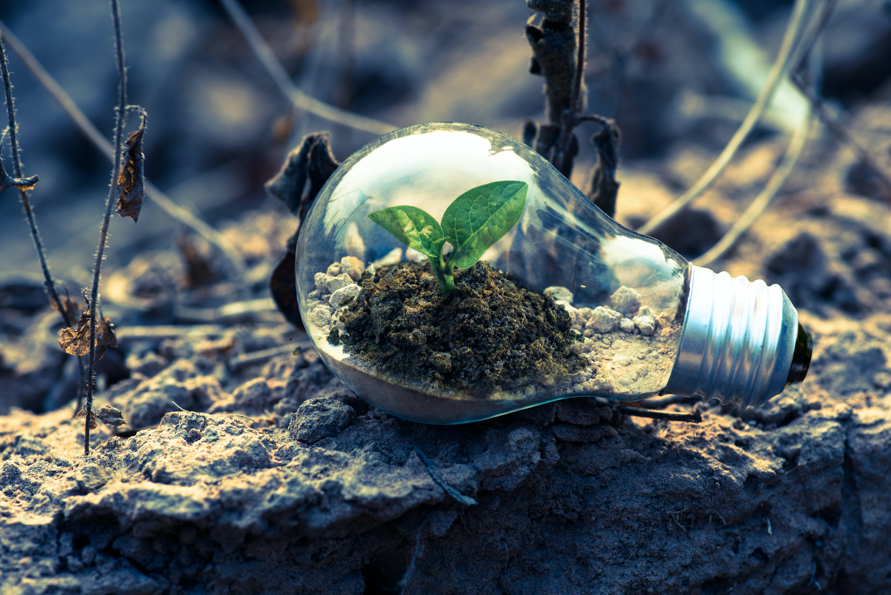
Thank you !

Slide 18
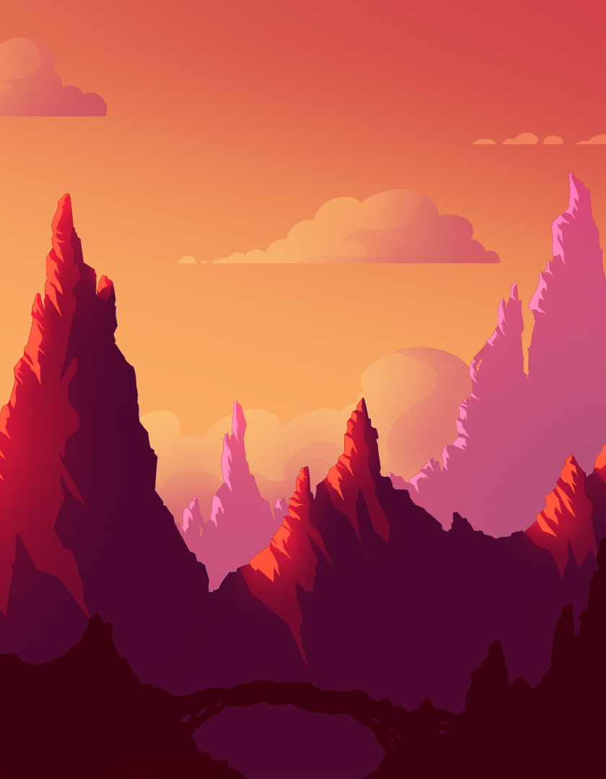
Environment & SDG Himalaya Fellowship
Made By:
Ujesh Sisodia 500091882
Hitendra Sisodia 500091910
Anirudh Srinivasan 500091739
Priyanshu Tandon 500091901
Kartikay Kanojia 500090998

